Slide 1

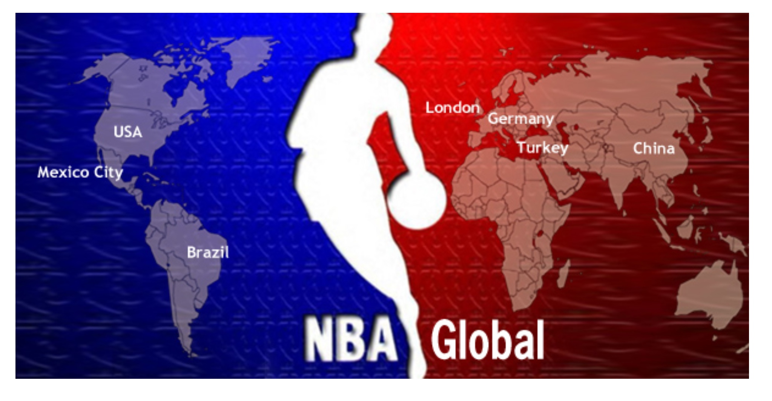

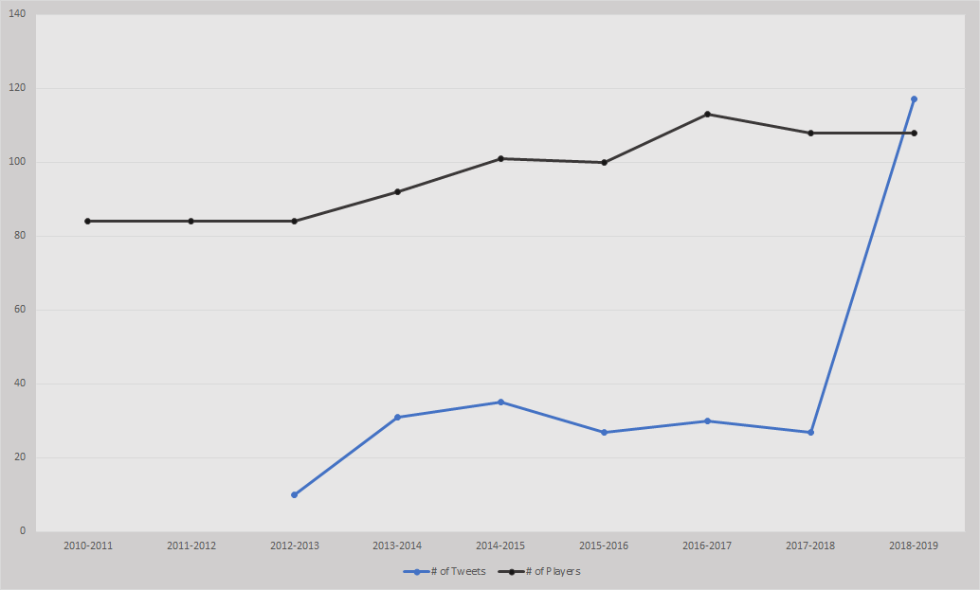


A DESCRIPTIVE STUDY OF INTERNATIONAL POSTS ON THE OFFICIAL NBA TWITTER PAGE
IN THE LAST FIVE YEARS
Tyler Freeburg, Benjamin Brackett, Dhurv Patel, Natanya Hernandez| Dr. Amanda Evert Southwestern Oklahoma State University
Abstract
Discussion
There are 108 international players on the National Basketball Association opening roster for the 2018-19 season and each of the 30 teams in the league currently have at least one international player. The purpose of this research is to analyze the posts of the official NBA Twitter page regarding international players and foreign countries. It is hypothesized that the number of NBA Twitter posts about international topics has increased in the last five years as a result of the increase in international players in the league.
The methodology used in this study is a content analysis utilizing data mining practices. Data will be shared from the official NBA Twitter account for any mentions of foreign countries or international players. Data will also be shared from the official NBA website for the signing dates of international players in the last five years. NBA rosters have become increasingly diverse in relation to the countries represented and this research investigates how the NBA promotes this international growth via Twitter.
In conclusion, the quest to study the NBA’s Tweets as they relate to international players and foreign countries resulted in finding a link between the rise in international players in the NBA and the quantity of Tweets on their page relating to international affairs. This has therefore led to an exciting correlation. This correlation suggests that the overall marketing efforts to get the attention of foreign basketball players has increased in response to the growing importance these players have on the NBA franchise. The effect of the international marketing efforts for the NBA are far-reaching and include a variety of facets that, we believe will continue to shape the culture of the NBA in years to come.
Introduction
CHART AXIS LABEL
Future Research
As a group, we wanted to find just how important international players are in the world of the National Basketball Association (NBA). As viewers, we have seen the NBA grow since its creation in 1946. The fans and consumers have seen it expand, not only in the United States, but also globally. This has been a key aspect for the NBA. The NBA has had the ability to increase their marketing dramatically, grow their amount of players, and raise revenues exponentially. The NBA has grown into a multi-billion dollar company and a component of that is the growing quantity of international players. The NBA released in 2018, that they had “108 international players from 42 different countries”(NBA). There were only 301 players in the NBA for the 2018-2019 season. With 108 international players, they make up nearly 40% of the NBA rosters. How much do international players and teams influence the NBA? The international players and fans play a massive role and have given the NBA the opportunity to grow as a whole.
Research Findings
In the future, it would be beneficial to do the following:
· Expand the search both in the aspects of time and content
· Reach to the time of the beginning of the NBA´s Twitter account as it relates to international marketing would provide more data.
· Include the NBA´s platform of Instagram as well as the social media of individual NBA teams and their efforts to market the international audience.
The effects of this research provides a better understanding of the influence the NBA´s Twitter, specifically, has on international recognition as well as how the Twitter page is affected. Impacts of this research include showing the positive effects both parties -the NBA and international players- have had on each other. Improving the efforts in marketing to international players will prove beneficial for both the league and the players and this research conducted shines a light on that, showing that the two are correlated.
The findings include a comparison of the number of tweets published by the NBA per season and the number of international players contracted by the NBA. Taking these numbers, T-tests were run for the following:
Paired Two Sample- for Means
Two Sample- Assuming Unequal Variances
These were calculated with an alpha value of 0.05 and both tests resulted in a P-value well under the alpha value. With this evidence, it can be assumed that there is a statistical correlation in the amount of international players in the NBA and the amount of Tweets relating to international affairs.
It seems there is an important exchange of athletic ability happening. This exchange appears to have an effect on the manner in which the NBA carries out the social media marketing in the sense that in the last three years, most of the Tweets have been directly from the NBA. Whereas before the 2016 season, there were more Tweets by international players themselves, These Tweets were those of which the NBA reposted to use on their own page as well.
Although the increase in Tweets by the NBA mentioning international players or teams could be due to other external factors, this correlation is interesting in determining the effect one aspect has on the other. This increase in Twitter activity could be due to a more valued importance with social media marketing and since the overall posts increased, the number of international posts would reasonably increase as well. However the overall correlation found seems to point to a more direct effort by the NBA to attract the attention of international players and leagues through their Twitter marketing specifically.
CHART TITLE
Literature Review
In the article, NBA Continues International Expansion, Aims To Be No 1 Sport, Adam Silver stated: “I believe we can be the No. 1 sport in the world. When I look at the trajectory of growth, the fact that young people, boys and girls, continue to love this sport, are playing this sport, are engaged in the sport of basketball on social media or with online games, I don't know what the limit is” (Wheeler, 2018),
In the 2005 article Show me the Money! The Globalization of the NBA written by Tanner D. Gardner, the overall effect of globalization on the NBA franchise is massive. Mr. Gardner focuses on the far-reaching impact that the NBA has and in turn, how countries aside from the United States are affecting the NBA culture.
In the development of NBA in China: a glocalization perspective. The authors look at the “ analyzing of its current promotional practices, investigating into its marketing strategies, and extrapolating practical references for other sport leagues aiming to penetrating into the Chinese marketplace” (Zhou, Weng, Chen, Lei, Zang, and Meng) in relation to the NBA.
In the last five years, there have been significant changes in the opportunity for foreign players and their popularity through social media. In the opening of the 2013-2014 season, the NBA consisted of 92 foreign players, with 39 international players entering the draft later that season (NBA, 2013). The growth of the international players continued to increase in the 2014-2015 season with a record breaking 101 international players in the season opening from over 39 countries (NBA, 2014). With the rise in international players there were also spikes of players and coaches mentioning them on twitter. In the next two seasons, the NBA would again break the record for the most international players in a season opening with a staggering 108 international players in both the 2015-2016 and 2016-2017 season. (NBA, 20115)
During the 1999 season, the only two players from foreign countries to average at least 15 points per game were Dirk Nowitzki and Tim Duncan. These were two of the 24 international players in the league at that time (Reynolds, 2019). In the past two decades the amount of international players has increased by more than four times with 11 of them being all stars.
CHART LABEL
CHART LABEL
Works Cited
Aschburner, S. (2014, October 29). 'City game' now world's game; The changing face of the NBA. Retrieved from NBA: http://www.nba.com/2014/news/features/steve_aschburner/10/28/the-international-influence-mainbar/
Gardner, T., & O’Brien, A. J. (2005). Show me the Money! The Globalization of the NBA.
NBA. (2018, October 16). NBA rosters feature 108 international players from 42 countries and territories. Retrieved from NBA Communications: https://pr.nba.com/nba-rosters-feature-108-international-players-from-42-countries-and-territories/
NBA Continues International Expansion, Aims To Be No 1 Sport. (2018, October 15). Retrieved from https://www.legalgamblingandthelaw.com/news/nba-continues-international-expansion-with-goal-to-become-no-1-sport/
Reynolds, T. (2019, January 2). On Basketball: International Stars Leaving Mark on NBA. Retrieved from The Seattle TImes: https://www.seattletimes.com/sports/on-basketball-international-stars-leaving-mark-on-nba/
Staff, T. N. (2015, January 14). International Influence. Retrieved from http://www.nba.com/news/international-influence-index/
Zhou, L., Wang, J. J., Chen, X., Lei, C., Zhang, J. J., & Meng, X. (2017). The development of NBA in China: a glocalization perspective. International Journal of Sports Marketing and Sponsorship, 18(1), 81-94.
NBA (14, Oct 31) “NBA Sets record with 101 international players from 37 countries and territories”.
NBA (13, Oct 29)” Record-breaking 92 international players from 39 countries and territories featured on opening night rosters”. [Tweet]
NBA(15, Oct 27) “The NBA announced that 100 international players from 37 countries and territories are on opening night rosters for the 2015-2016 season”. [Tweet]
NBA(16, Oct 25) “ The NBA says there are 113 international players from 41 countries and territories on opening night rosters” [Tweet]
t-Test: Paired Two Sample for Means
 | 10 | 84
Mean | 44.5 | 103.66667
Variance | 1270.3 | 56.266667
Observations | 6 | 6
Pearson Correlation | 0.261829935
Hypothesized Mean Difference | 0
df | 5
t Stat | -4.207330764
P(T<=t) one-tail | 0.004214926
t Critical one-tail | 2.015048373
P(T<=t) two-tail | 0.008429852
t Critical two-tail | 2.570581836
 | t-Test: Two-Sample Assuming Unequal Variances
 |  | Variable 1 | Variable 2
 | Mean | 39.57142857 | 100.85714
 | Variance | 1228.619048 | 102.14286
 | Observations | 7 | 7
 | Hypothesized Mean Difference | 0
 | df | 7
 | t Stat | -4.444860058
 | P(T<=t) one-tail | 0.001495059
 | t Critical one-tail | 1.894578605
 | P(T<=t) two-tail | 0.002990117
 | t Critical two-tail | 2.364624252
Methodology
For this study, we conducted the following:
1. A content analysis based on the rosters for international players
2. The NBA´s Twitter feed was data mined to find any reference of international topics
3. This explained how many international players or international areas are mentioned on the personal sites, while seeing the popularity of the post that they presented
4. For the Social Media Analysis, we tallied up the amount of times international players are in the NBA’s Twitter post and which ones gained the most attention from viewers
5. During the process of analyzing and assembling material, we also used individual sites which provided more context to the recent surge in numbers for both international players actively employed in the NBA and, in response, the marketing efforts on the NBA´s Twitter page.
The information we found was during a time period of the last five years. This time scale gave us a better understanding of the growth of international players and the importance of their existence in the NBA.

